Slide 1

A
- BY SAHIL VIJAY SHELAR
M
M
A
Y
B
Y
E
S
G
A
D
T

Slide 2
B
Y
M
G
D
T
A
S
M
A
A
E
Y
BY TECH TITANS
ITVEDANT (VASHI)

Slide 3
A
- BY SAHIL VIJAY SHELAR
M
M
A
Y
B
Y
About Project
E
S
G
A
D
T
The aim of this project is to design and implement a database for a gym management system, which includes handling members' data, their interactions with gym trainers, and purchases from the gym café.
The project demonstrates the use of SQL queries such as sub queries and joins to manage and analyze interconnected tables efficiently.

Slide 4
About Project
The aim of this project is to design and implement a database for a gym management system, which includes handling members' data, their interactions with gym trainers, and purchases from the gym café.
The project demonstrates the use of SQL queries such as sub queries and joins to manage and analyze interconnected tables efficiently.

Slide 5




TABLES IN MY DATABASE
MEMBER TABLE
TRAINER TABLE
PERSONAL TRAINING TABLE
CAFE TABLE

Slide 6



MEMBERS TABLE STRUCTURE AND INSERTED DATA
CREATE TABLE Members (
member_id INT PRIMARY KEY AUTO_INCREMENT,
first_name VARCHAR(50),
last_name VARCHAR(50),
gender CHAR(1),
membership_type VARCHAR(20),
join_date DATE,
phone VARCHAR(15));
insert into Members (first_name, last_name, gender, membership_type, join_date, phone) values('Sahil','Shelar','m','gold','2023-01-01',8591650200),
('Rohit','Sawant','m','gold','2023-01-11',2546785461),
('aniket','tetme','m','gold','2023-01-13',9000024536),(
'Sakshi','Badhe','f','silver','2023-01-15',1546859751),
('avinash','Sekr','m','platinum','2023-01-19',95555662213),
('krishna','Shirsat','m','gold','2023-02-01',98564725156),
('kapil','patil','m','silver','2023-02-16',9696545784),
('pavan','Shirsat','m','silver','2023-02-25',9565478245),
('pari','gadge','f','gold','2023-02-28',9987878784),
('snehal','Shelar','f','silver','2023-03-03',9956487256),
('Saujanya','gadge','f','gold','2023-03-03',9956122213),
('krunal','parthe','m','gold','2023-01-06',9999564875),
('snehal','Shinde','f','silver','2023-06-25',8522356545),
('vijay','Shelar','m','platinum','2023-05-25',8585754847),
('rishabh','tavdare','m','silver','2023-05-28',8595252525),
('kunal','nalawade','m','gold','2024-06-21',8844775657),('shreyash','Sawant','m','platinum','2023-06-15',8592564870),('aditya','kapre','m','platinum','2023-10-01',8889995476),……………………

Slide 7



TRAINER TABLE AND INSERTED DATA
CREATE TABLE Trainers (
trainer_id INT,
first_name VARCHAR(50),
last_name VARCHAR(50),
specialization VARCHAR(50),
experience INT );
INSERT INTO Trainers VALUES (101,'karan','shete','weight_training',6),
(102,'varsha','shelar','yoga',2),
(104,'sanyukta','gadge','women_trainer',8),
(105,'siddesh','wayase','strengthtrainer',9),
(106,'junaid','khan','cardio',4),
(107,'karam','shelar','sports_traie',3);

Slide 8



PERSONAL TRAINING TABLE STRUCTURE AND DATA
CREATE TABLE Personal_Training (
member_id INT,
trainer_id INT,
assigned_date DATE,
PRIMARY KEY (member_id, trainer_id), FOREIGN KEY (member_id) REFERENCES Members(member_id), FOREIGN KEY (trainer_id) REFERENCES Trainers(trainer_id));
INSERT INTO Personal_Training VALUES
(1,101,'2023-01-02'),(2,101,'2023-01-12'),(3,101,'2023-01-14’),
(4,102,'2023-01-17'),(5,104,'2023-01-13'),(6,105,'2023-02-10’),
(7,105,'2023-02-18'),(8,105,'2023-02-28'),(9,102,'2023-02-28’),
(10,104,'2023-03-04'),(11,104,'2023-03-04'),(12,104,'2023-01-07’),
(13,104,'2023-06-25'),(14,106,'2023-05-25'),(15,106,'2023-05-28’),
(16,107,'2023-06-21'),(17,107,'2023-06-15'),(18,107,'2023-10-01’),
(19,107,'2023-07-22'),(20,107,'2023-11-14'),(21,101,'2023-07-27’),
(22,106,'2023-12-12'),(23,106,'2023-10-14'),(24,106,'2023-06-11’),
(25,101,'2023-04-11');

Slide 9


GYM CAFÉ TABLE STRUCTURE AND DATA
CREATE TABLE Gym_Cafe (
order_id INT PRIMARY KEY AUTO_INCREMENT, member_id INT,
item VARCHAR(50), price DECIMAL(6, 2),
FOREIGN KEY (member_id) REFERENCES Members(member_id));
INSERT INTO Gym_Cafe (member_id, item, price)VALUES
(1, 'Smoothie', 50),(2, 'Sandwich', 60),(1, 'Coffee', 20),(4, 'Shake', 40),
(5, 'Chicken Rice', 100),(6, 'Smoothie', 50),(7, 'Coffee', 20),(8, 'Sandwich', 60),
(11, 'Shake', 40),(10, 'Chicken Rice', 100),(11, 'Smoothie', 50),(12, 'Coffee', 20),
(13, 'Sandwich', 60),(14, 'Shake', 40),(15, 'Chicken Rice', 100),(6, 'Smoothie', 50),
(1, 'Coffee', 20),(18, 'Sandwich', 60),(2, 'Shake', 40),(20, 'Chicken Rice', 100),
(11, 'Smoothie', 50),(22, 'Coffee', 20),(13, 'Sandwich', 60),(24, 'Shake', 40),
(25, 'Chicken Rice', 100),(1, 'Shake', 40),(2, 'Coffee', 20),(3, 'Chicken Rice', 100),
(14, 'Smoothie', 50),(5, 'Sandwich', 60),(6, 'Shake', 40),(7, 'Chicken Rice', 100),
(8, 'Smoothie', 50),(19, 'Coffee', 20),(10, 'Sandwich', 60),
(11, 'Chicken Rice',100),(2, 'Shake', 40),(13, 'Smoothie', 50),
(1, 'Coffee', 20),(15, 'Sandwich', 60),(16, 'Chicken Rice', 100),
(7, 'Smoothie', 50),(8, 'Shake', 40),(19, 'Coffee', 20),
(20, 'Sandwich', 60),(21, 'Chicken Rice', 100),
(2, 'Shake', 40),(2, 'Smoothie', 50),(13, 'Coffee', 20),
(25, 'Sandwich', 60);

Slide 10
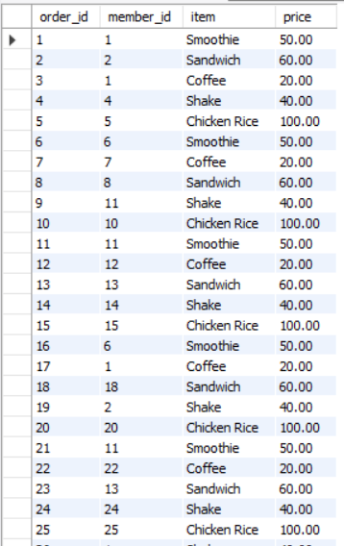
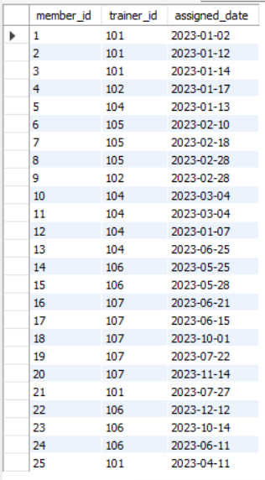
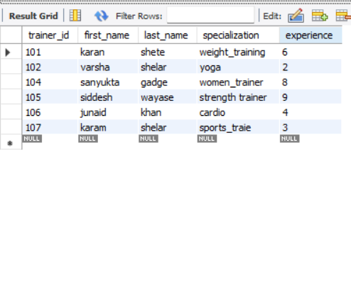
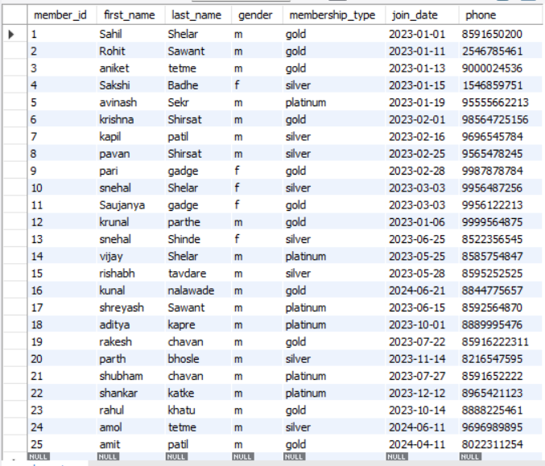
PERSONAL TRAINER
TRAINERS
MEMBERS
CAFE’S
OUTPUT
OF ALL TABLES

Slide 11
PERSONAL TRAINER
MEMBERS
TRAINERS
CAFE’S

Slide 12
WHAT TYPES OF SQL QUERIES I HAVE USED…
01
COUNT
function is used to count the number of rows that match a specified condition. Here

Slide 13
WHAT TYPES OF SQL QUERIES I HAVE USED…
01
02
COUNT
DISTINCT
function is used to count the number of rows that match a specified condition. Here
used to remove duplicates from the result set, returning only unique values.

Slide 14
WHAT TYPES OF SQL QUERIES I HAVE USED…
01
02
03
COUNT
DISTINCT
JOIN
function is used to count the number of rows that match a specified condition. Here
used to remove duplicates from the result set, returning only unique values.
used to combine rows from two or more tables based on a related column between them.

Slide 15
WHAT TYPES OF SQL QUERIES I HAVE USED…
01
02
03
04
COUNT
DISTINCT
JOIN
SUBQUERIS
function is used to count the number of rows that match a specified condition. Here
used to remove duplicates from the result set, returning only unique values.
used to combine rows from two or more tables based on a related column between them.
allow you to retrieve data that will be used in the main (outer) query.

Slide 16
WHAT TYPES OF SQL QUERIES I HAVE USED…
01
02
03
04
05
COUNT
DISTINCT
JOIN
SUBQUERIS
VIEW
function is used to count the number of rows that match a specified condition. Here
used to remove duplicates from the result set, returning only unique values.
used to combine rows from two or more tables based on a related column between them.
allow you to retrieve data that will be used in the main (outer) query.
It does not store data physically but provides a way to present data from one or more tables

Slide 17

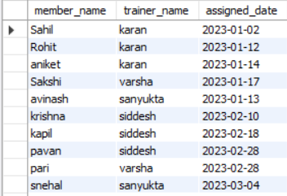

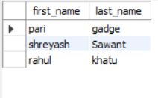
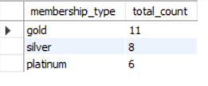
SUB-QUERIES
Join Query to Get Members and Their Trainers
SELECT M.first_name AS member_name,
T.first_name AS trainer_name, PT.assigned_dateFROM Members as M
JOIN personal_training as PT
ON M.member_id = PT.member_id
JOIN Trainers as T ON PT.trainer_id = T.trainer_id;
get members who dont buy anything from cafe
VIEWS
JOINS
SELECT m.first_name, m.last_name
FROM Members as m
LEFT JOIN Gym_Cafe c
ON m.member_id = c.member_id
WHERE c.member_id IS NULL;
membership type count
SELECT membership_type,
COUNT(*) AS total_countFROM MembersGROUP BY membership_type;
AGGREGGATE FUNCTIONS

Slide 18

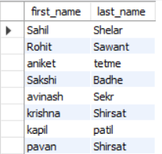
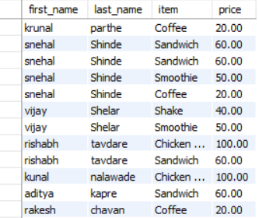
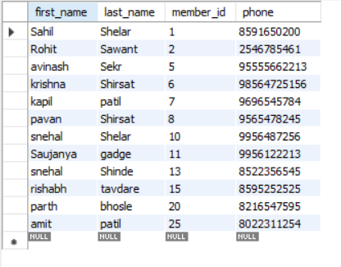
SUB-QUERIES
Get Members Who Have Purchased in the Gym Cafe
SELECT first_name, last_name
FROM Members
WHERE member_id IN ( SELECT member_id FROM Gym_Cafe );
Get Members and Their Cafe Purchases
VIEWS
JOINS
SELECT M.first_name, M.last_name,
C.item, C.price FROM Members as M
JOIN Gym_Cafe as C
ON M.member_id = C.member_id;
Find the Members Who Spent More Than 100 at the Cafe
SELECT first_name, last_name, member_id,phone
FROM MembersWHERE member_id
IN ( SELECT member_id
FROM Gym_Cafe
GROUP BY member_id
HAVING SUM(price) > 100);
AGGREGGATE FUNCTIONS

Slide 19

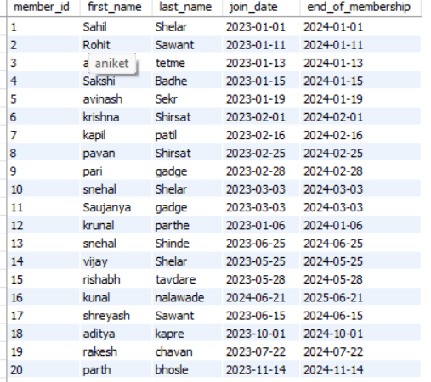
SUB-QUERIES
GET THE EXPIRY OF MEMBERSHIP OF MEMBERS
CREATE VIEW MemberDetails AS
SELECT member_id,
first_name, last_name, join_date, DATE_ADD(join_date, INTERVAL 1 YEAR) AS end_of_membership
FROM Members;
VIEWS
JOINS
AGGREGGATE FUNCTIONS

Slide 20
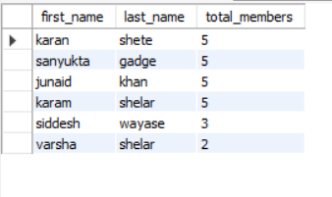
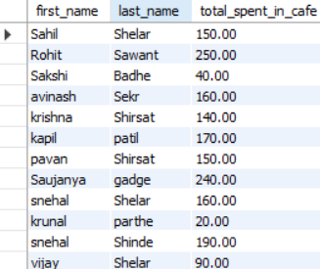
SUB-QUERIES
Find Trainers with Most Members
SELECT T.first_name, T.last_name,
COUNT(PT.member_id) AS total_members
FROM Trainers as T
JOIN personal_training PT
ON T.trainer_id = PT.trainer_id
GROUP BY T.trainer_id
ORDER BY total_members DESC;
VIEWS
JOINS
Get Total Purchases by Each Member
SELECT M.first_name, M.last_name,
SUM(C.price) AS total_spent_in_cafe
FROM Members as M
JOIN Gym_Cafe as C
ON M.member_id = C.member_id
GROUP BY M.member_id;
AGGREGGATE FUNCTIONS

Slide 21
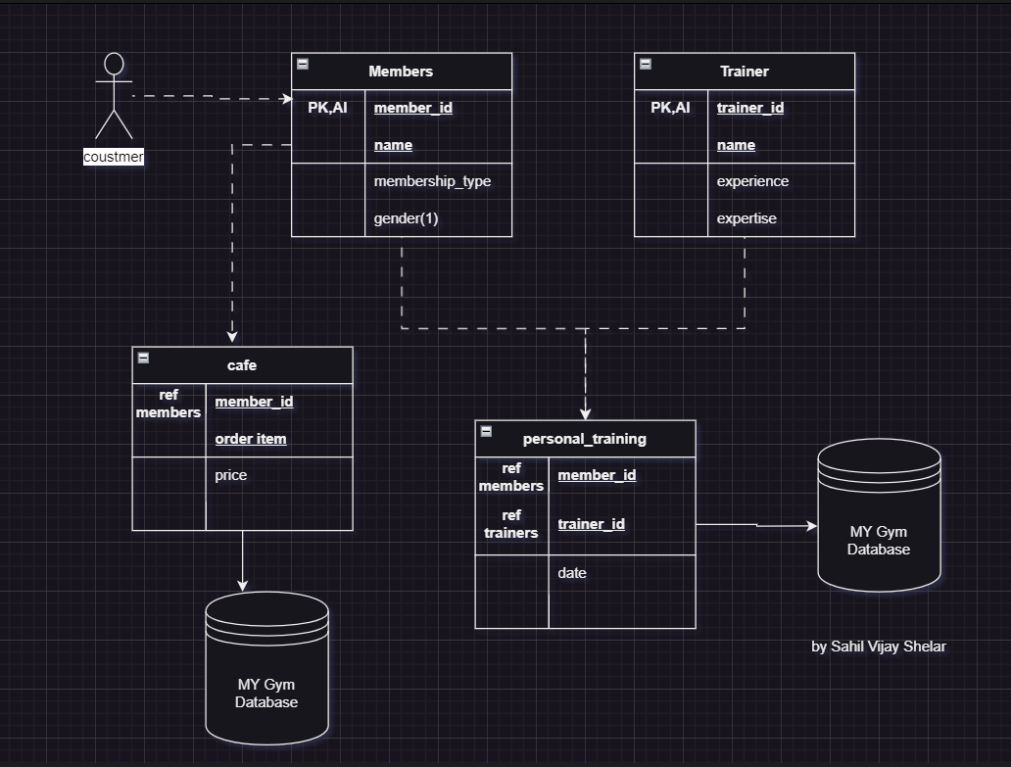
ER-DIGRAM
As you seen in my ER-Diagram member table, trainer table, café table & personal training are there.
Basically, member table and trainer table are joined together to store info in personal training table .
Café table have information of member tables . All those table data are going to store in MY GYM DATABASE.

Slide 22
ER-DIGRAM
As you seen in my ER-Diagram member table, trainer table, café table & personal training are there.
Basically, member table and trainer table are joined together to store info in personal training table .
Café table have information of member tables . All those table data are going to store in MY GYM DATABASE.

Slide 23

T
K
A
H
U
N
Y

Slide 24
O
A
N
T
K
H
Y
U

